Slide 1
Lecture 5: Procurement and Slowly Changing Dimensions
Chapter 5

Slide 2
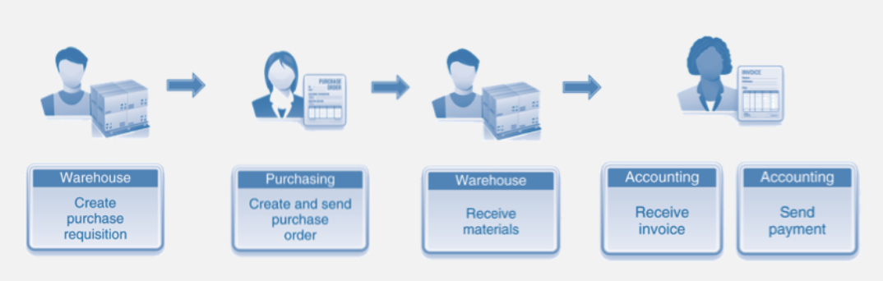
Procurement Processes
Procurement is a critical business activity: (1). Effective procurement of products at the right price for resale; (2). buys products as raw materials for manufacturing;
Procurement involves activities from negotiating contracts to issuing purchase requisitions and purchase orders (POs) to tracking receipts and authorizing payments.
Significant cost savings opportunities are associated with reducing the number of suppliers and negotiating agreements with preferred suppliers.

Slide 3
Procurement Transactions and Bus Matrix
A collection of procurement transactions, such as purchase requisitions, purchase orders, shipping notifications, receipts, and payments.
Grain: one row per procurement transaction;
Key dimensions: transaction date, product, vendor, contract terms, and procurement transaction type;
Facts: The procurement transaction quantity and dollar amount;

Slide 4
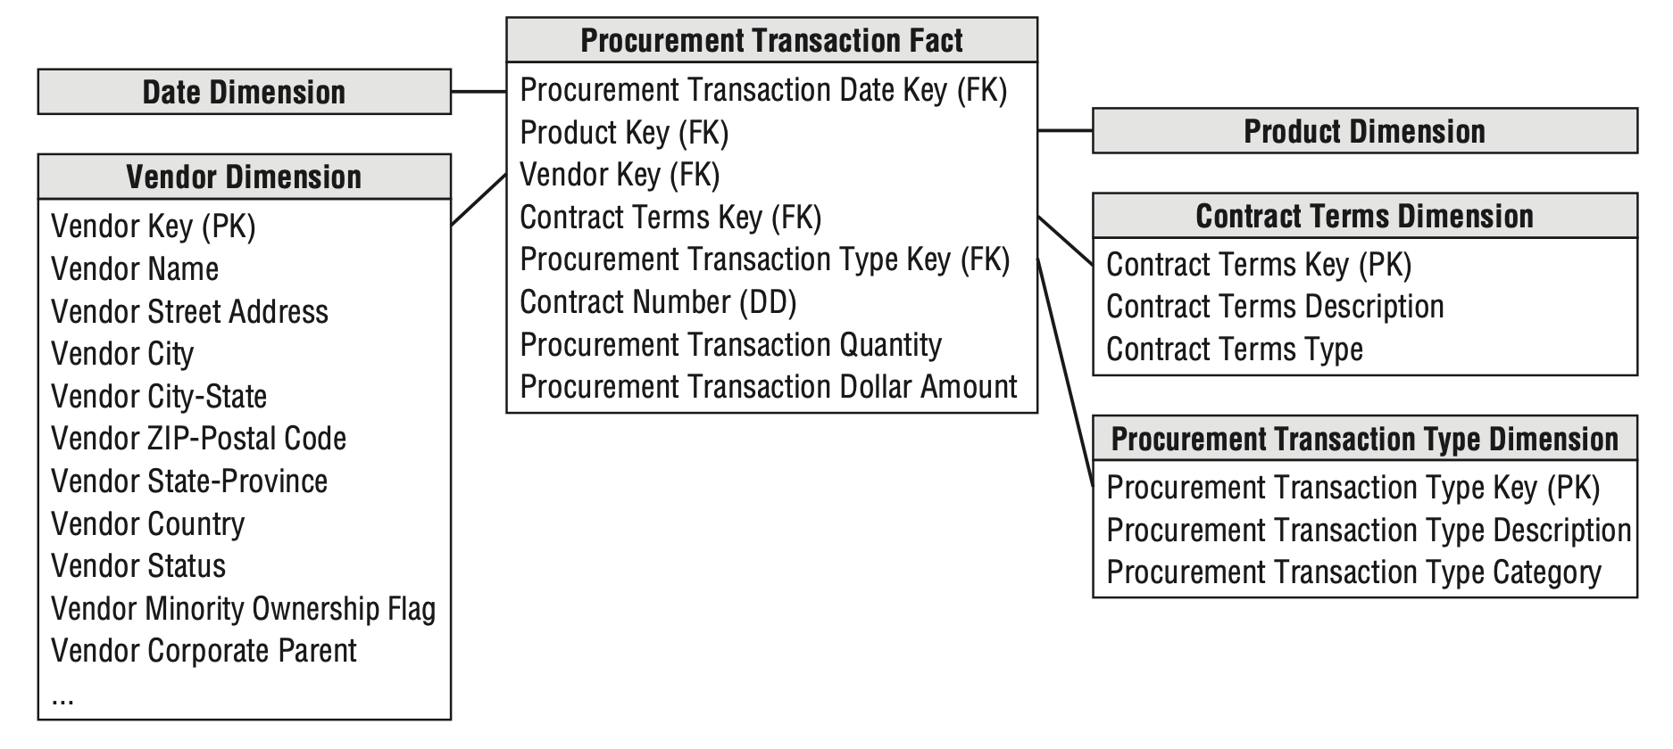
Procurement fact table with multiple transaction types
The vendor dimension contains one row for each vendor;
The contract terms dimension contains one row for each generalized set of negotiated terms;
The procurement transaction type dimension enables grouping or filtering on transaction types, such as purchase orders;
The contract number is a degenerate dimension;

Slide 5
Single Versus Multiple Transaction Fact Tables
To the business, purchase orders, shipping notices, warehouse receipts, and vendor payments are all viewed as separate and unique processes.
Several transaction types have different dimensionality.
Discounts taken are applicable to vendor payments but not to the other transaction types.
Different control numbers, such as purchase order and payment check numbers, created at various steps in the procurement pipeline.
Candidates for degenerate dimensions;
More than one control number may apply for certain transaction types.

Slide 6
Single Versus Multiple Transaction Fact Tables
Should you build a blended transaction fact table, or do you build separate fact tables for each transaction type?
What are the users’ analytic requirements?
The goal is to reduce complexity by presenting the data in the most effective form for business users.
Are there really multiple unique business processes?
Buying products (purchase orders) is distinctly different from receiving products (receipts).
Are multiple source systems capturing metrics with unique granularities?
Three separate source systems: purchasing, warehousing, and accounts payable.
What is the dimensionality of the facts?
Several dimensions are applicable to some transaction types but not to others.

Slide 7
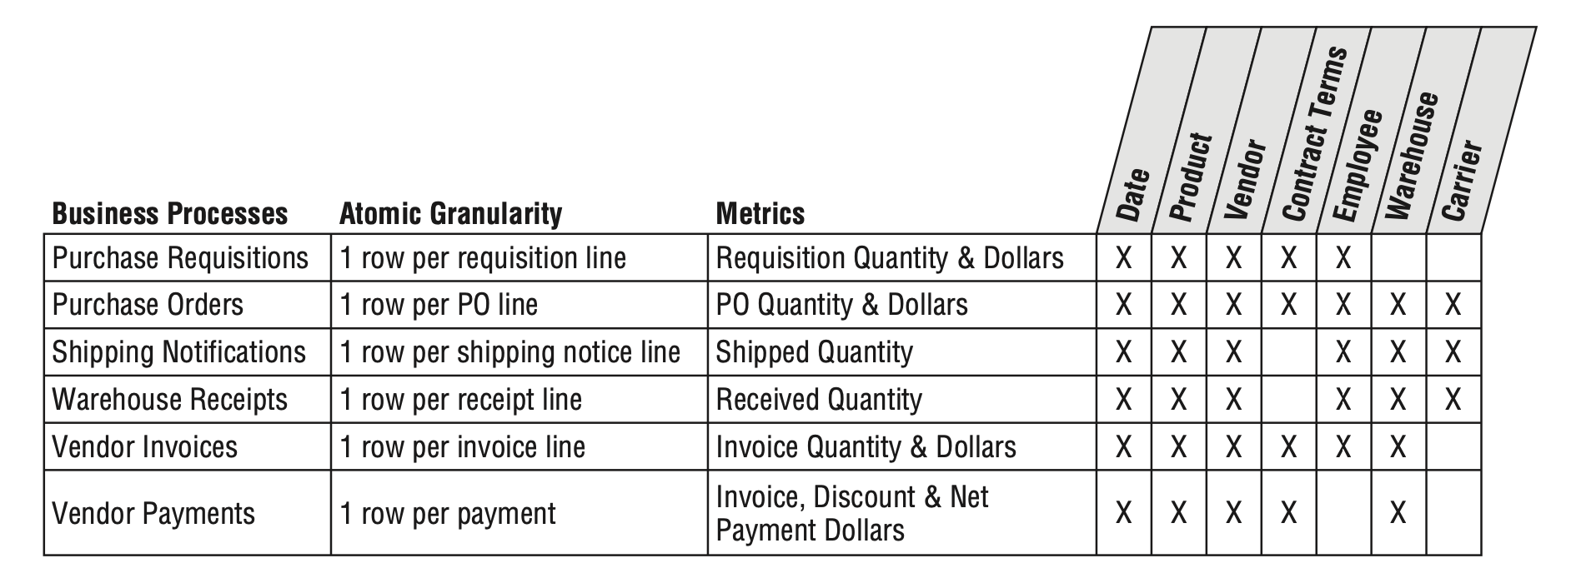
Sample bus matrix rows for procurement processes.

Slide 8
What is the trade-off?
Multiple fact tables:
enable richer, more descriptive dimensions and attributes;
may require more time to manage and administer because there are more tables to load, index, and aggregate
The single fact table:
Require generalized labeling for some dimensions.
For example, purchase order date and receipt date would likely have been generalized to simply transaction date. Likewise, purchasing agent and receiving clerk would become employee

Slide 9
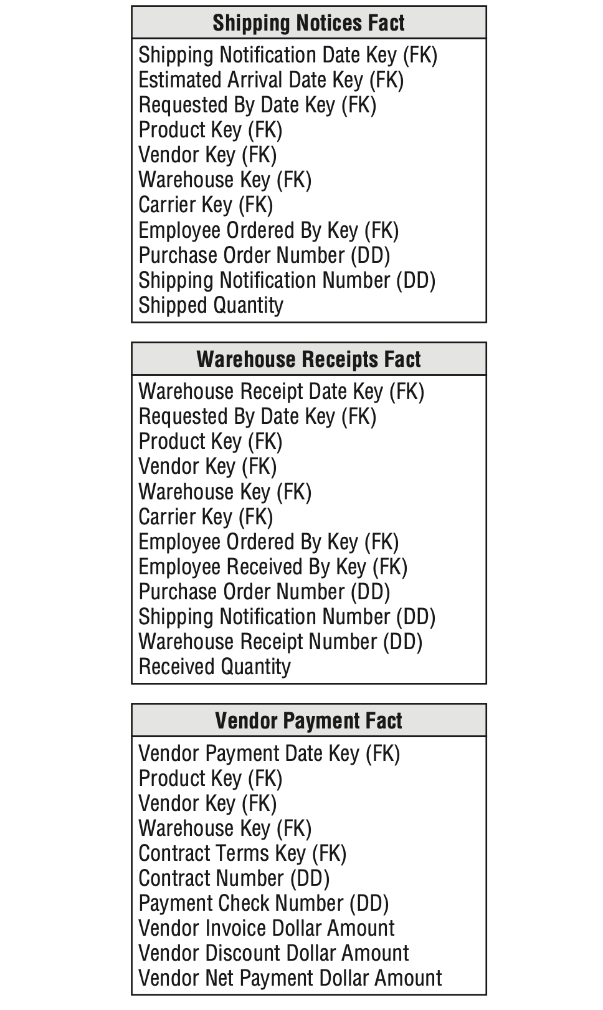
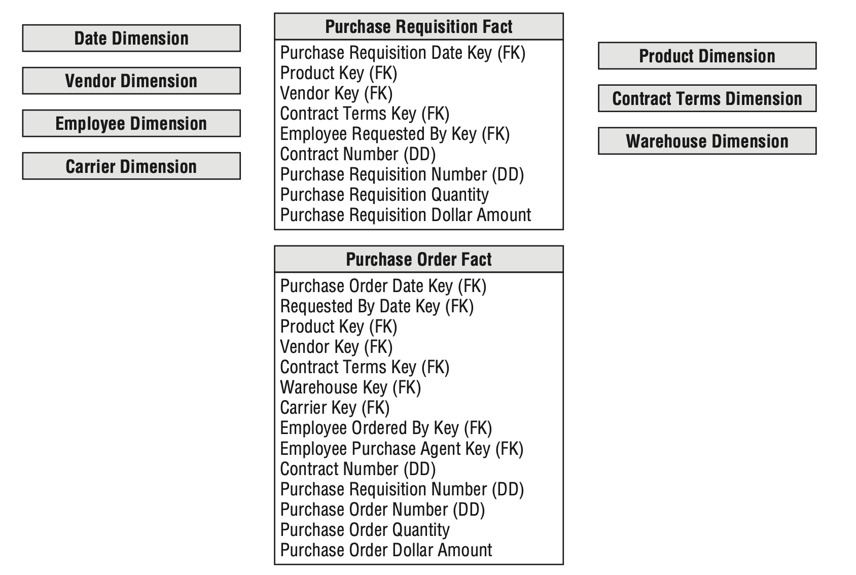
Multiple fact tables for procurement processes.

Slide 10
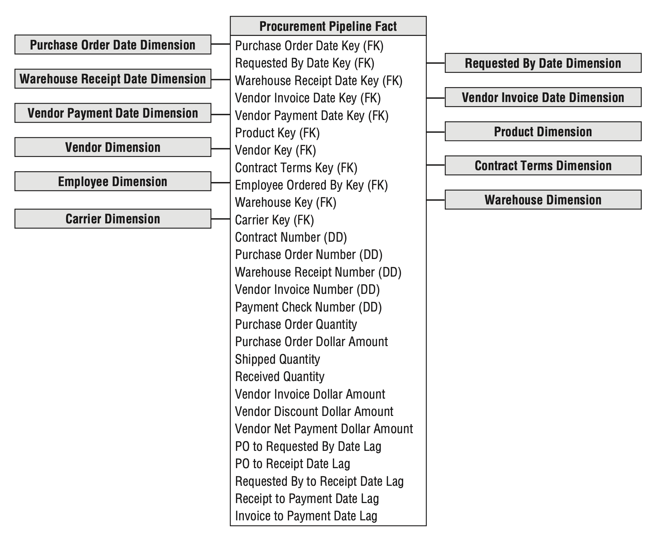
Complementary Procurement Snapshot: Procurement pipeline accumulating snapshot schema

Slide 11
Slowly Changing Dimension Basics
SCDs - attribute values that change slowly and unpredictably over time; Different type of SCDs - different change tracking techniques
Type 0: Retain Original
Type 1: Overwrite
Type 2: Add New Row
Type 3: Add New Attribute
Type 4: Add Mini-Dimension

Slide 12
Type 0: Retain Original
With type 0, the dimension attribute value never changes, so facts are always grouped by this original value
Once we load it, we don’t change it; All changes are disregarded;
Type 0 is appropriate for any attribute labeled “original”;
Customer original credit score.
Most attributes in a date dimension;
Persistent durable keys are always type 0 attributes

Slide 13

Type 1: Overwrite
The old value is overwritten by the new value
Reflects only the most recent assignment
No history
Before Change
After Change

Slide 14

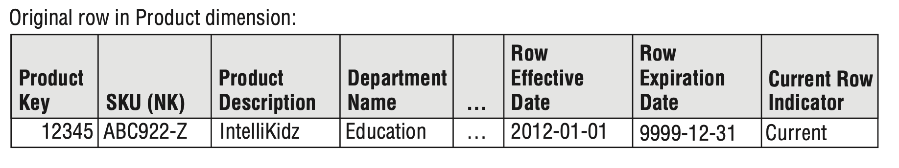
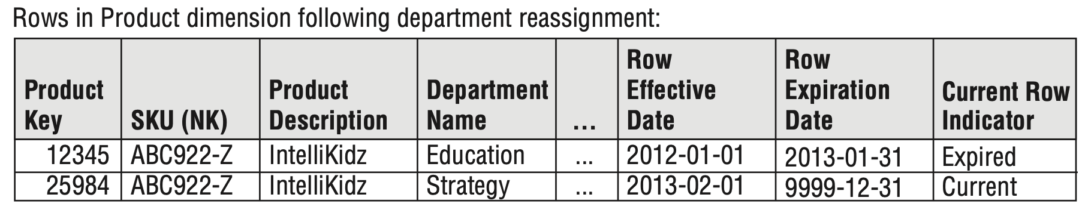
Type 2: Add New Row
Represents the history of changing attribute values
A new dimension row is inserted
New surrogate key is assigned

Slide 15
Type 2: Add New Row
Type 2 Effective and Expiration Dates
Effective and expiration dates or date/time stamps are necessary in the ETL system because it needs to know which surrogate key is valid when loading historical fact rows;
Type 1 Attributes in Type 2 Dimensions
Mix multiple slowly changing dimension techniques within the same dimension.
No need to revisit preexisting aggregation tables;
Use the SKU natural key attribute as the basis of the distinct count rather than the surrogate key;
The natural key column becomes the glue that holds the separate type 2 rows for a single product together.

Slide 16
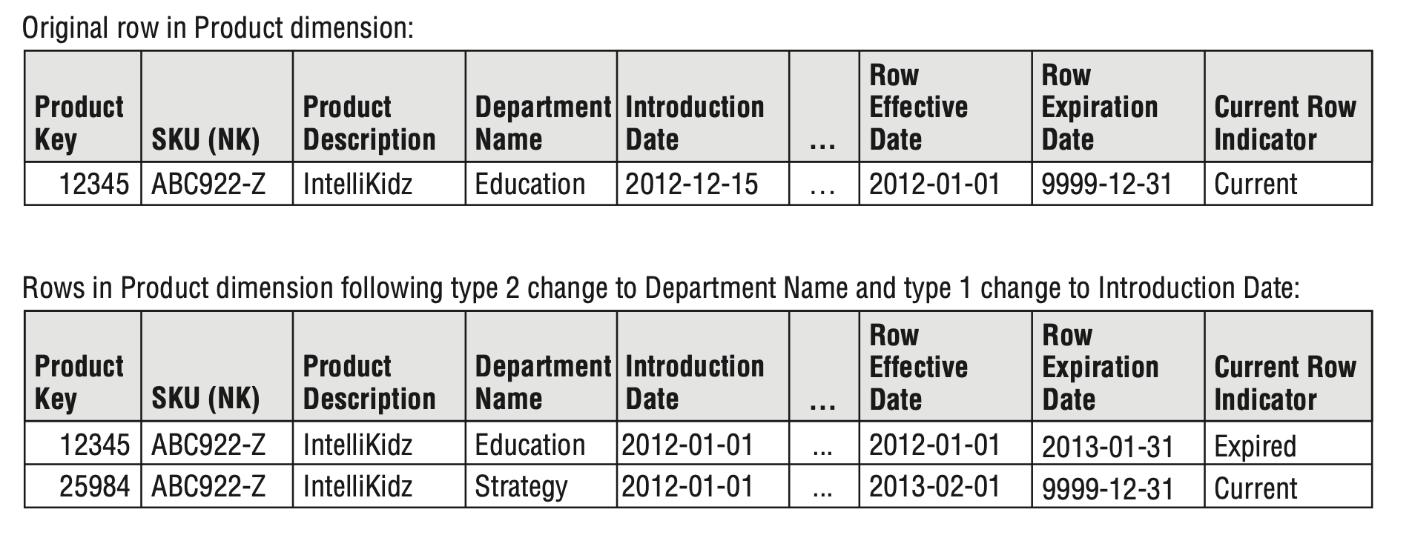
Type 2: Add New Row

Slide 17

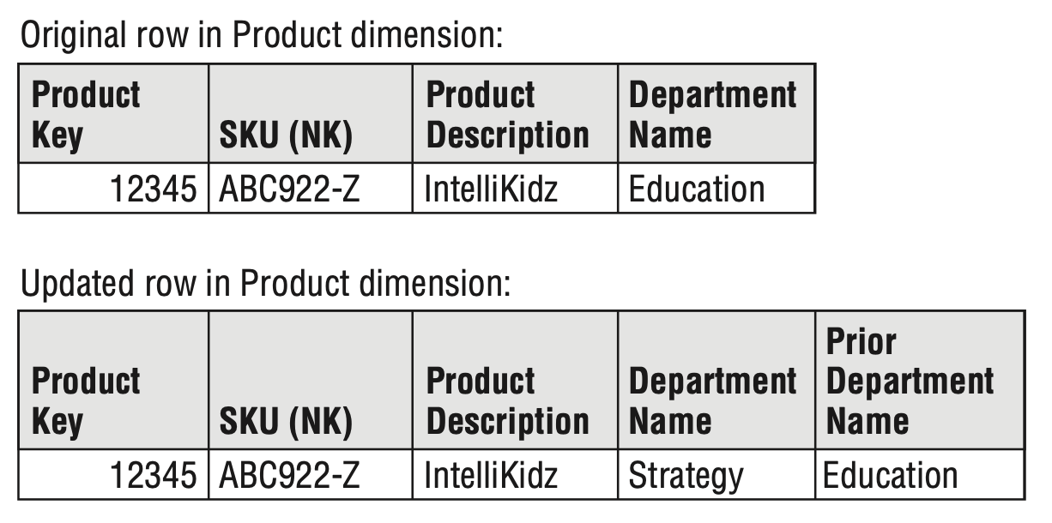
Type 3: Add New Attribute
Additional column is used
Original value is overwritten (SCD 1)
Reports can still use the old value
Sometimes called “Alternate Reality”
When there’s a significant change impacting many rows in the dimension table;
Infrequently used: strong need to support two views of the world simultaneously;
Not useful for attributes that change unpredictably;
Customer’s home state

Slide 18
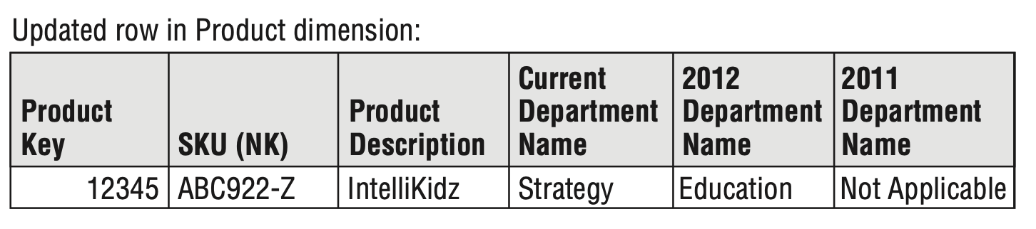
Type 3: Add New Attribute
Multiple Type 3 Attributes
Imagine the product line is recategorized at the start of every year and the business wants to look at multiple years of historic facts based on the department assignment for the current year or any prior year.

Slide 19
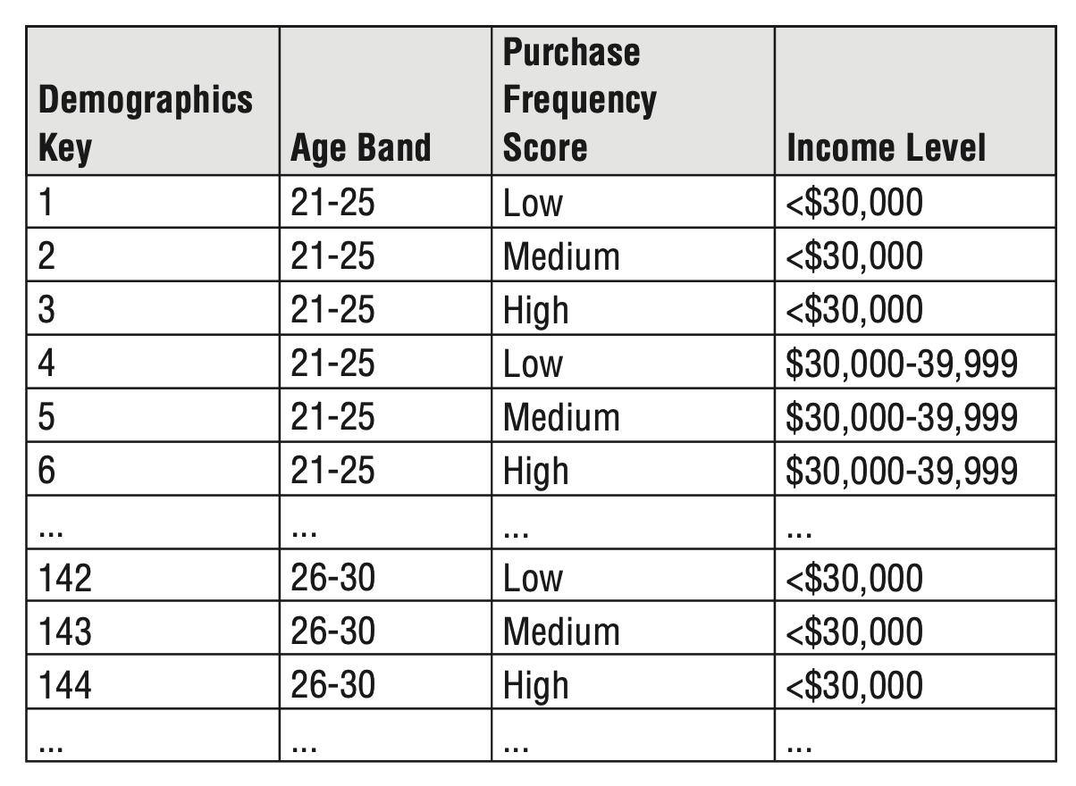
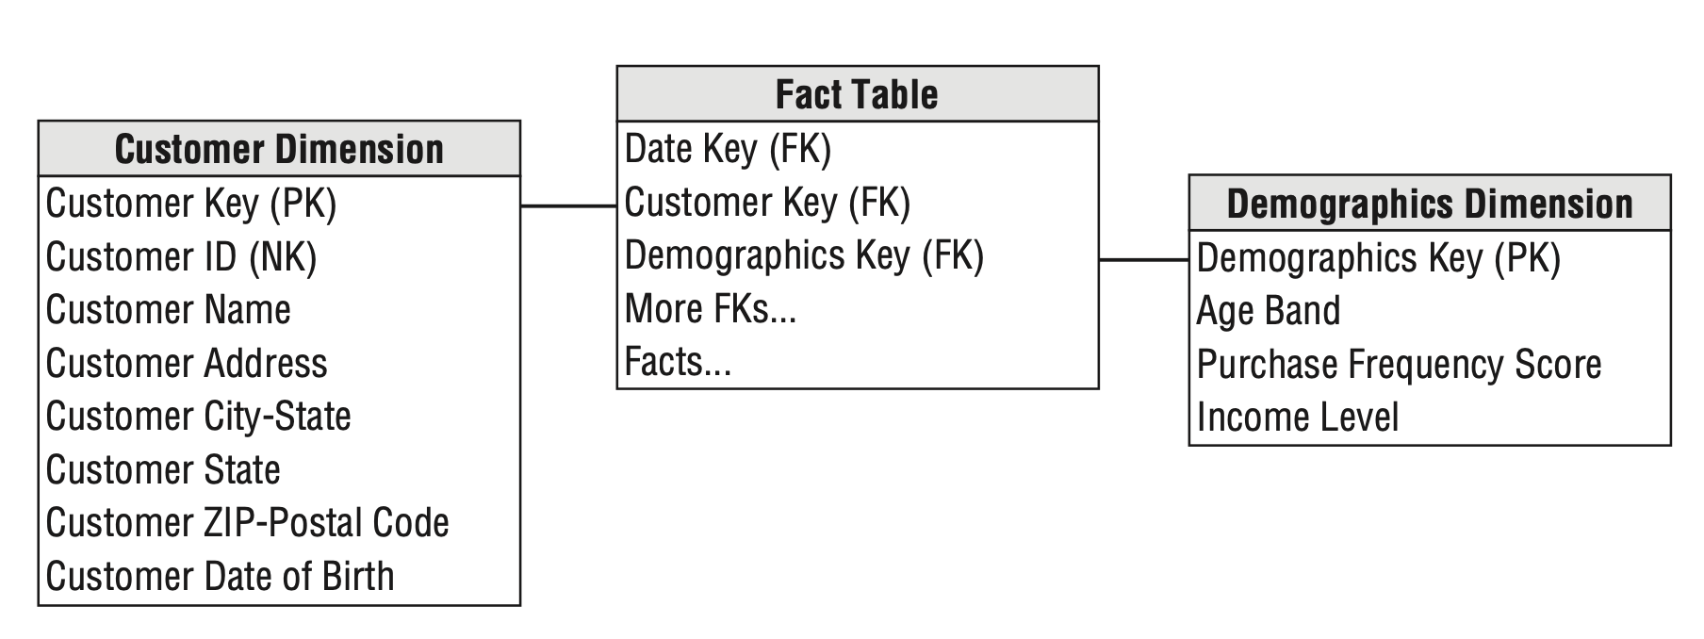
Type 4: Add Mini-Dimension
Attributes are split off to a mini-dimension
Applied to: - Rapidly Changing Dimensions (RCD) - to frequently used attributes in multimillion-row dimensions
Fact tables capture the both surrogate keys

Slide 20
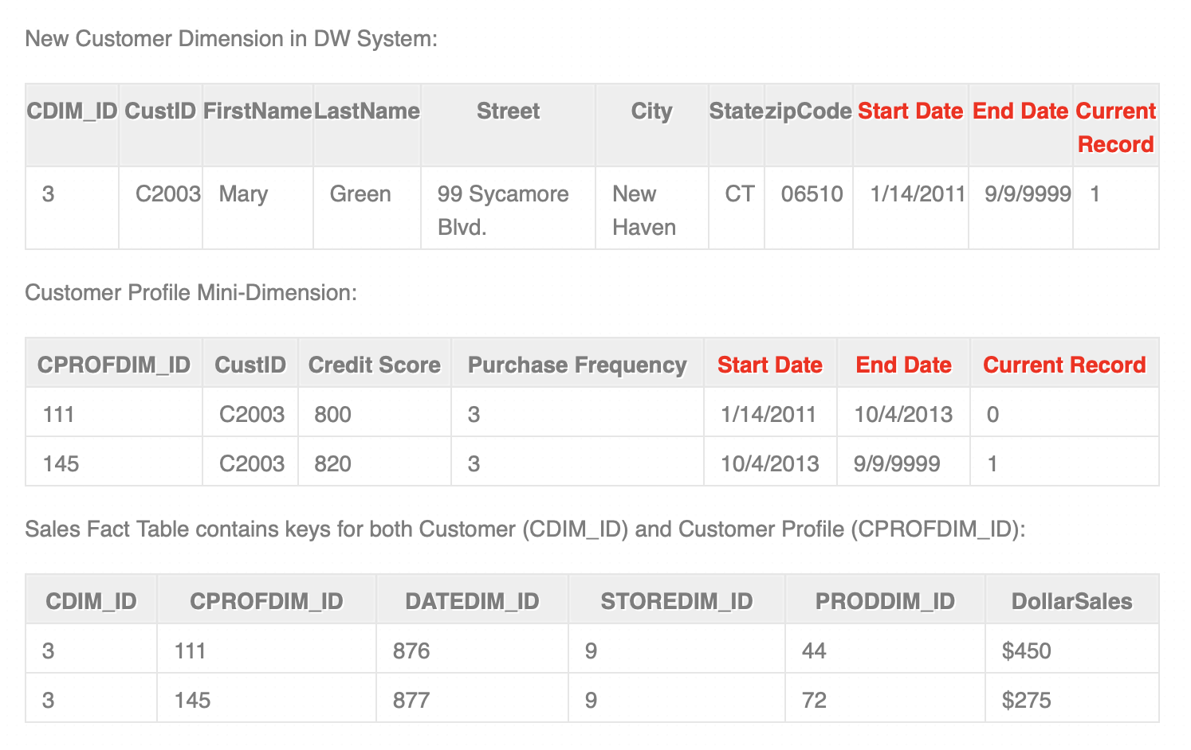
Type 4 Examples:

Slide 21
Hybrid Slowly Changing Dimension Techniques
Type 5: Add Mini-Dimension and Type 1 Outrigger
This technique is named type 5 because 4 + 1 equals 5
Type 6: Add Type 1 Attributes to Type 2 Dimension
This technique is named type 6 because 3 + 2 + 1 and 3 x 2 x 1 both equal 6
Type 7: Dual Type 1 and Type 2 Dimensions

Slide 22
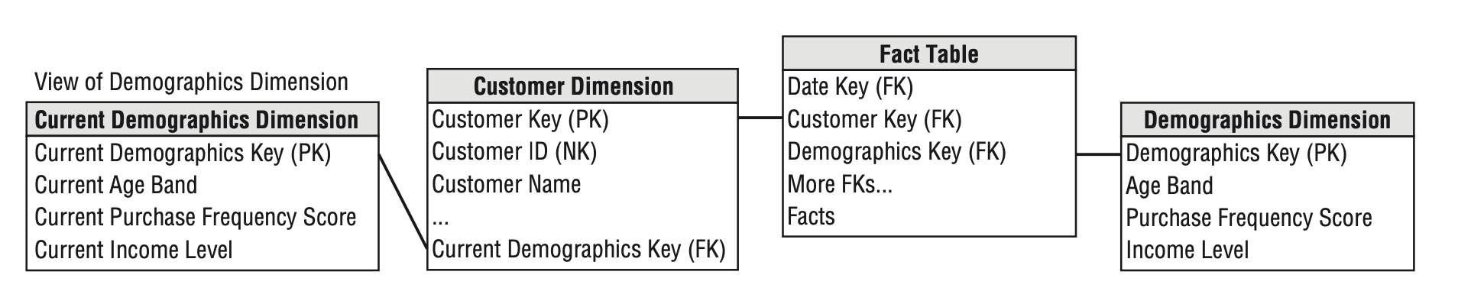
Type 5: Add Mini-Dimension and Type 1 Outrigger
SCD 5 is an enhancement to SCD 4 technic
A mini-dimension primary key is added to the base dimension as SCD 1 attribute
Allows to: - analyze current mini-dimension attribute values without involving a fact table - roll up historical facts based on the current mini-dimension attribute values
(roll up historical facts based on the customer’s current profile)

Slide 23
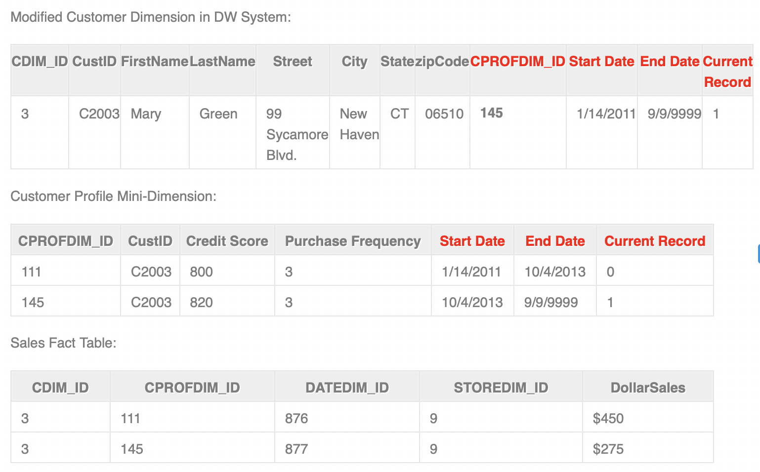
Type 5 Examples:

Slide 24
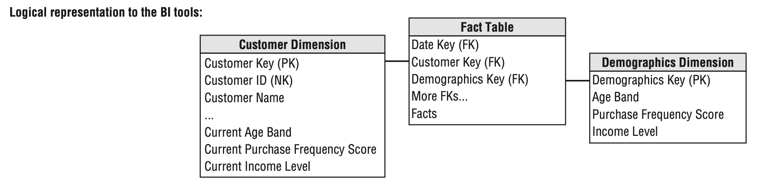
Type 5: Logical Representation to the BI tools
The base dimension and the mini-dimension outrigger are represented as a singe table in the presentation area for the BI tools

Slide 25
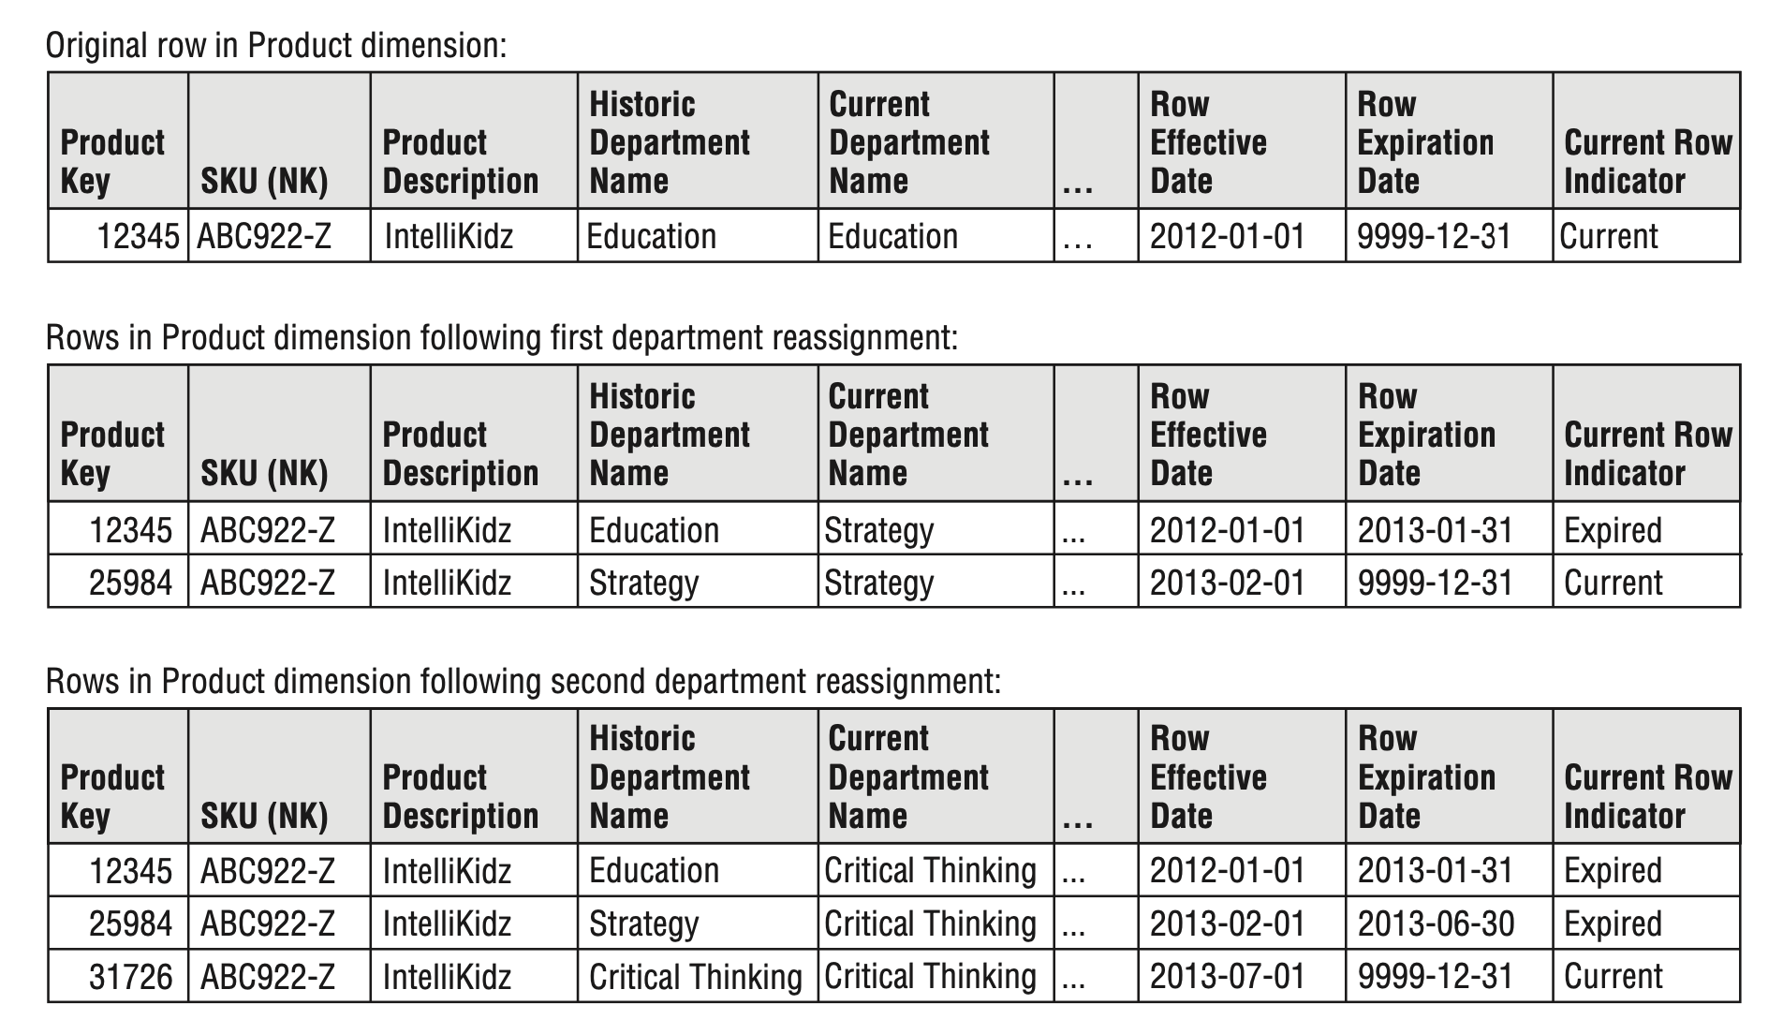
Type 6: Add Type 1 Attributes to Type 2 Dimension
Additional column (SCD 3) for the attribute: - one for tracking historic values (SCD 2) - one for representing the current assignment (SCD 1)
Allows to analyze historic facts based on historic attribute values as well as on the current ones

Slide 26
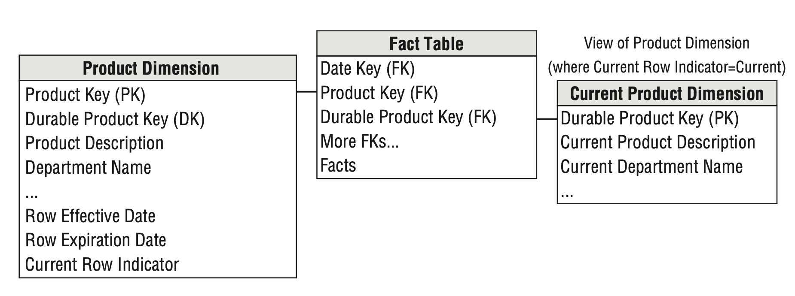
Type 7: Dual Type 1 and Type 2 Dimensions
Supports both current and historic perspectives for many attributes
Both business key and surrogate key are included into a fact table
The business key joins to a dimension with the current values (SCD 1)
Queries based on current attribute values filter on a smaller dimension table

Slide 27
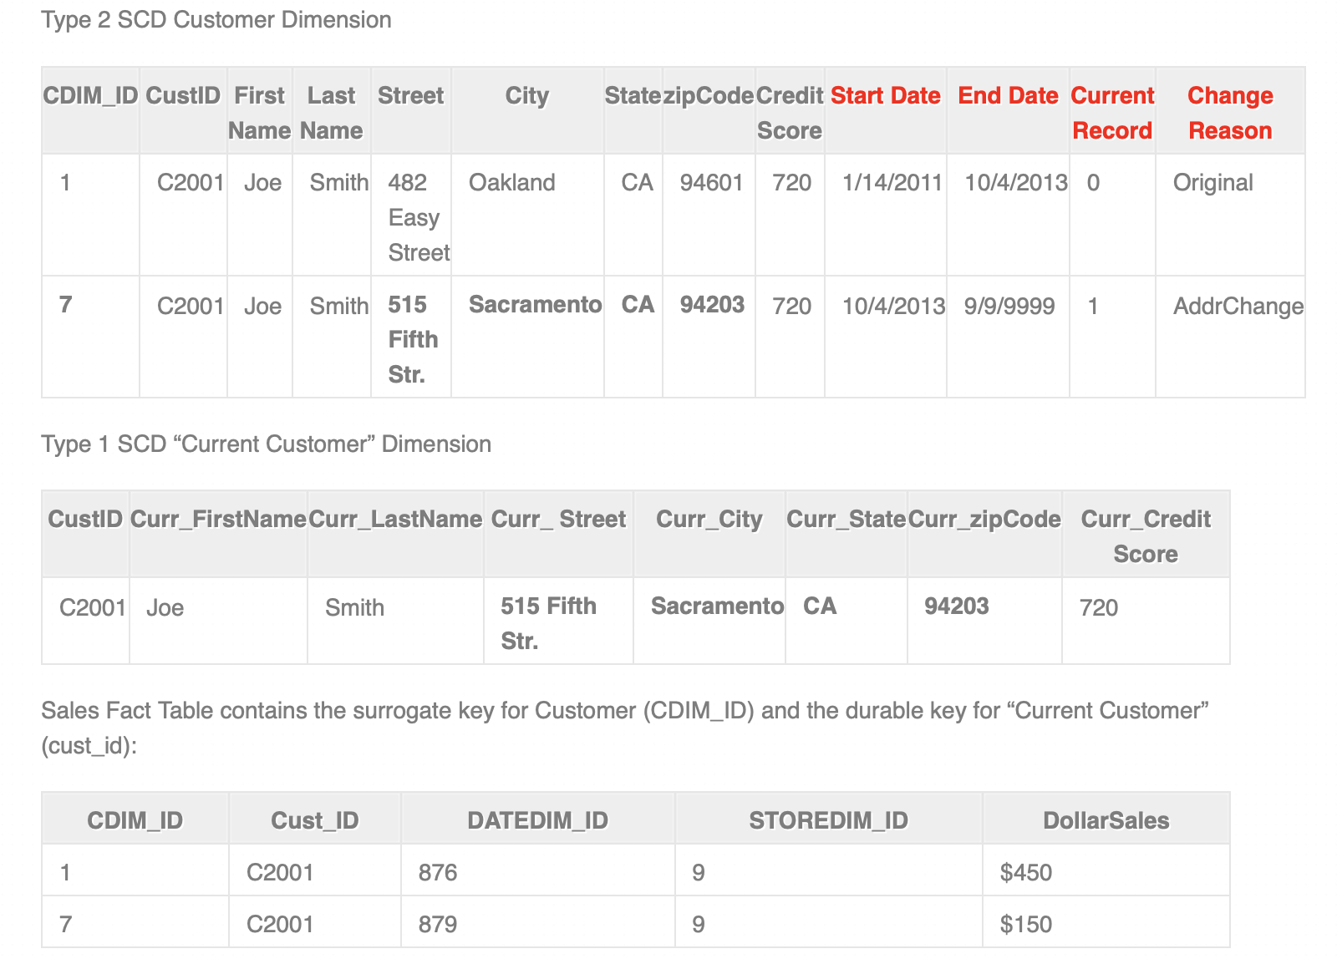
Type 7 Examples

Slide 28
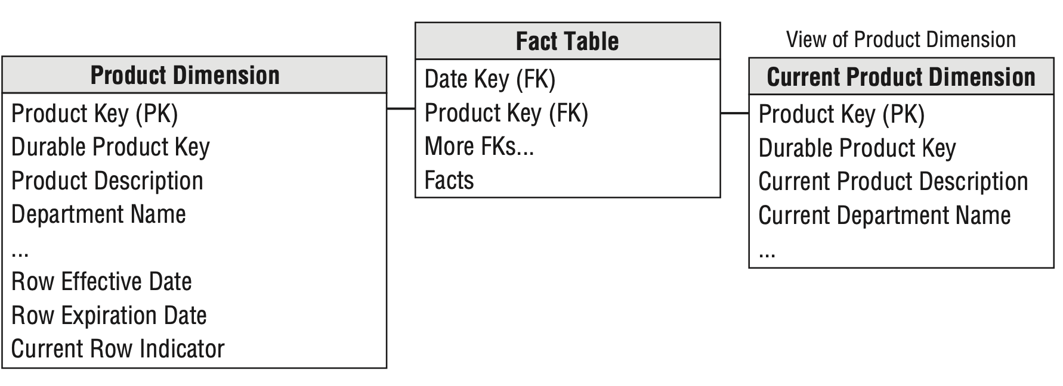
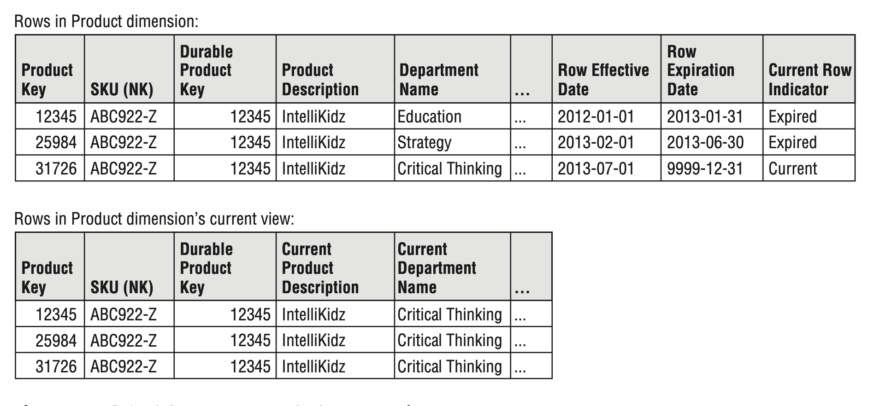
Type 7: Alternative Approach with Single Surrogate Key
Each surrogate key is associated with the current value
Both dimensions in this case have equal number of rows

Slide 29
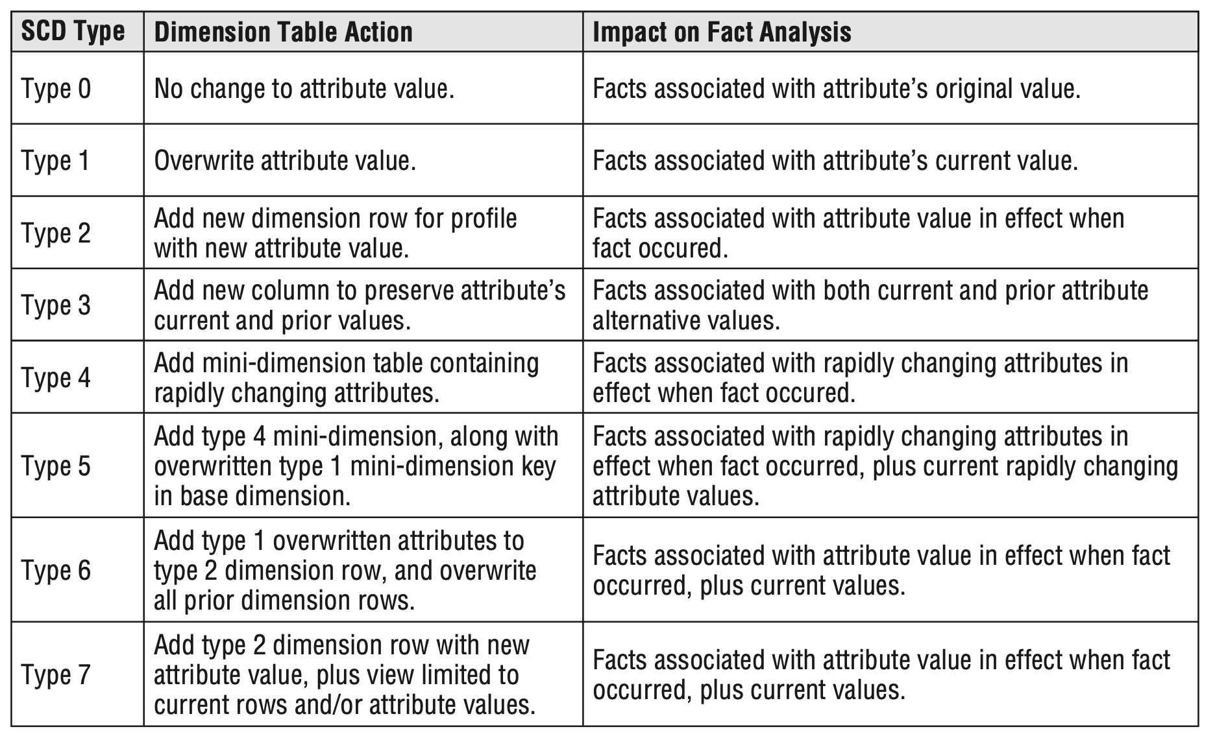
Slowly changing dimension techniques summary

